Slide 1

EECS 370 - Lecture 23
Making Virtual Memory Fast + 370 Wrap-Up
Live Poll + Q&A: slido.com #eecs370
Poll and Q&A Link

Slide 3
Announcements
P4
Last project!
Due Thu (4/13)
HW 6
Last homework!
Due Monday (4/17)
Final exam
…Last exam!
Thu (4/20) @ 10:30 am
Sample exams will be posted
(One sample exam given in homework)

Slide 4
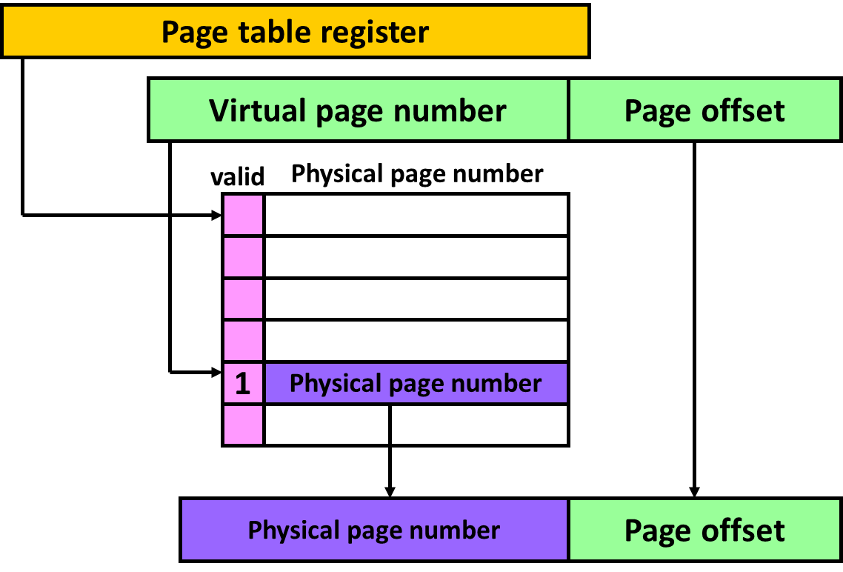
Reminder
We use a “page table” to translate “virtual” addresses (specified by the programmer / assembler) to “physical” addresses (sent to memory)
Allows multiple programs to run without interfering with each other
Allows programs to use more storage than available in DRAM
By mapping virtual addresses to disk instead of DRAM

Slide 5
Review: Virtual to Physical Translation
Virtual address = 0x000040F3
Virtual page number
Page offset
0x00004
0x0F3
Translation
Process
0x020C0
0x0F3
Physical page number
Page offset
Physical address = 0x020C00F3

Slide 6
Review
To translate a virtual address into a physical address, we must first access the page table in physical memory
If it's an N-level page table, we must do N total loads before getting the physical page number
Then we access physical memory again to get the data
A load instruction performs at least 2 memory reads
A store instruction performs at least 1 read and then a write
Above lookups are SLOW

Slide 7
Translation look-aside buffer (TLB)
We fix this performance problem by avoiding main memory in the translation from virtual to physical pages.
Buffer common translations in a Translation Look-aside Buffer (TLB), a fast cache memory dedicated to storing a small subset of valid V-to-P translations.
16-512 entries common.
Generally has low miss rate (< 1%).
Poll: Why can we make TLBs smaller than the cache hierarchy?
Addresses are smaller than data
TLB is accessed less frequently than caches
Only need to store info about individual pages

Slide 8
Translation look-aside buffer (TLB)
Virtual page
Pg offset
Virtual address
v
tag
Physical page
TLB

Slide 9
Where is the TLB lookup?
We put the TLB lookup in the pipeline after the virtual address is calculated and before the memory reference is performed
This may be before or during the data cache access.
To be discussed next time
In case of a TLB miss, we need to perform the virtual to physical address translation during the memory stage of the pipeline.

Slide 10
Putting it all together
Loading your program in memory
Ask operating system to create a new process
Construct a page table for this process
Mark all page table entries as invalid with a pointer to the disk image of the program
That is, point to the executable file containing the binary.
Run the program and get an immediate page fault on the first instruction.

Slide 11
Loading a program into memory
Page size = 4 KB, Page table entry size = 4 B
Page table register points to physical address 0x0000
Disk Pages
Memory
2 entry TLB
VPN PPN Permission
D0
D1
D2
D3
Page Table
0
Physical Refs
References
0x0000
0x0004
0x7FFC
0x0008
0x2134
1
2
D1000
text1
3
D1001
text2
4
D1002
global data
5
D1003
6
7

Slide 12
Step 1: Read executable header & initialize page table
Disk Pages
Memory
2 entry TLB
VPN PPN Permission
D0
reserved
D1
D2
D3
Page Table
0
D1000
ro
Physical Refs
References
0x0000
0x0004
0x7FFC
0x0008
0x2134
1
D1001
ro
2
D1002
D1000
text1
no map
3
D1001
text2
no map
4
D1002
global data
no map
5
D1003
no map
6
7
no map

Slide 13
Step 2: Load PC from header & start execution
Disk Pages
Memory
2 entry TLB
VPN PPN Permission
D0
reserved
MISS!
D1
D2
D3
Page Table
0
D1000
ro
Physical Refs
References
0x0000
0x0004
0x7FFC
0x0008
0x2134
1
D1001
ro
2
D1002
D1000
text1
no map
3
D1001
text2
no map
4
D1002
global data
no map
5
D1003
no map
6
7
no map

Slide 14
Fetching instruction 0000
Disk Pages
Memory
2 entry TLB
VPN PPN Permission
D0
reserved
D1
D2
D3
Page Table
0
D1000
ro
Physical Refs
0x0000
Page fault
References
0x0000
0x0004
0x7FFC
0x0008
0x2134
1
D1001
ro
2
D1002
D1000
text1
no map
3
D1001
text2
no map
4
D1002
global data
no map
5
D1003
no map
6
7
no map

Slide 15
Fetching instruction 0000
Disk Pages
Memory
2 entry TLB
VPN PPN Permission
D0
reserved
0
M1
ro
D1
text1
D2
D3
Page Table
0
M1
ro
Physical Refs
0x0000
Page fault
References
0x0000
0x0004
0x7FFC
0x0008
0x2134
1
D1001
ro
2
D1002
D1000
text1
no map
3
D1001
text2
no map
4
D1002
global data
no map
5
D1003
no map
6
7
no map

Slide 16
Fetching instruction 0000
Disk Pages
Memory
2 entry TLB
VPN PPN Permission
D0
reserved
0
M1
ro
D1
text1
D2
D3
Page Table
0
M1
ro
Physical Refs
0x0000
Page fault
0x1000
References
0x0000
0x0004
0x7FFC
0x0008
0x2134
1
D1001
ro
2
D1002
D1000
text1
no map
3
D1001
text2
no map
4
D1002
global data
no map
5
D1003
no map
6
7
no map

Slide 17
Fetching instruction 0004
Disk Pages
Memory
2 entry TLB
VPN PPN Permission
D0
reserved
0
M1
ro
HIT!
D1
text1
D2
D3
Page Table
0
M1
ro
Physical Refs
0x0000
Page fault
0x1000
0x1004
References
0x0000
0x0004
0x7FFC
0x0008
0x2134
1
D1001
ro
2
D1002
D1000
text1
no map
3
D1001
text2
no map
4
D1002
global data
no map
5
D1003
no map
6
7
no map

Slide 18
Reference 7FFC
Disk Pages
Memory
2 entry TLB
VPN PPN Permission
D0
reserved
0
M1
ro
D1
MISS!
text1
D2
D3
Page Table
0
M1
ro
Physical Refs
0x0000
Page fault
0x1000
0x1004
References
0x0000
0x0004
0x7FFC
0x0008
0x2134
1
D1001
ro
2
D1002
D1000
text1
no map
3
D1001
text2
no map
4
D1002
global data
no map
5
D1003
no map
6
7
no map

Slide 19
Reference 7FFC
Disk Pages
Memory
2 entry TLB
VPN PPN Permission
D0
reserved
0
M1
ro
D1
text1
D2
D3
Page Table
0
M1
ro
Physical Refs
0x0000
Page fault
0x1000
0x1004
0x0007
No map page fault
References
0x0000
0x0004
0x7FFC
0x0008
0x2134
1
D1001
ro
2
D1002
D1000
text1
no map
3
D1001
text2
no map
4
D1002
global data
no map
5
D1003
no map
6
7
no map

Slide 20
Reference 7FFC
Disk Pages
Memory
2 entry TLB
VPN PPN Permission
D0
reserved
0
M1
ro
D1
text1
7
M2
rw
D2
set to 0s
D3
Page Table
0
M1
ro
Physical Refs
0x0000
Page fault
0x1000
0x1004
0x0007
No map page fault
0x2FFC
References
0x0000
0x0004
0x7FFC
0x0008
0x2134
1
D1001
ro
2
D1002
D1000
text1
no map
3
D1001
text2
no map
4
D1002
global data
no map
5
D1003
no map
6
7
M2

Slide 21
Fetching instruction 0008
Disk Pages
Memory
2 entry TLB
VPN PPN Permission
D0
reserved
0
M1
ro
HIT!
D1
text1
7
M2
rw
D2
set to 0s
D3
Page Table
0
M1
ro
Physical Refs
0x0000
Page fault
0x1000
0x1004
0x0007
No map page fault
0x2FFC
0x1008
References
0x0000
0x0004
0x7FFC
0x0008
0x2134
1
D1001
ro
2
D1002
D1000
text1
no map
3
D1001
text2
no map
4
D1002
global data
no map
5
D1003
no map
6
7
M2

Slide 22
Reference 2134
Disk Pages
Memory
2 entry TLB
VPN PPN Permission
D0
reserved
0
M1
ro
MISS!
D1
text1
7
M2
rw
D2
set to 0s
D3
Page Table
0
M1
ro
Physical Refs
0x0000
Page fault
0x1000
0x1004
0x0007
No map page fault
0x2FFC
0x1008
References
0x0000
0x0004
0x7FFC
0x0008
0x2134
1
D1001
ro
2
D1002
D1000
text1
no map
3
D1001
text2
no map
4
D1002
global data
no map
5
D1003
no map
6
7
M2

Slide 23
Reference 2134
Disk Pages
Memory
2 entry TLB
VPN PPN Permission
D0
reserved
0
M1
ro
D1
text1
7
M2
rw
D2
set to 0s
D3
Page Table
0
M1
ro
Physical Refs
0x0000
Page fault
0x1000
0x1004
0x0007
No map page fault
0x2FFC
0x1008
0x0002
Page fault
References
0x0000
0x0004
0x7FFC
0x0008
0x2134
1
D1001
ro
2
D1002
D1000
text1
no map
3
D1001
text2
no map
4
D1002
global data
no map
5
D1003
no map
6
7
M2

Slide 24
Reference 2134
Disk Pages
Memory
2 entry TLB
VPN PPN Permission
D0
reserved
0
M1
ro
D1
text1
2
M3
rw
D2
set to 0s
D3
global data
Page Table
0
M1
ro
Physical Refs
0x0000
Page fault
0x1000
0x1004
0x0007
No map page fault
0x2FFC
0x1008
0x0002
Page fault
0x3134
References
0x0000
0x0004
0x7FFC
0x0008
0x2134
1
D1001
ro
2
M3
D1000
text1
no map
3
D1001
text2
no map
4
D1002
global data
no map
5
D1003
no map
6
7
M2

Slide 25
Next topic: Placing Caches in a VM System
VM systems give us two different addresses:
virtual and physical
Which address should we use to access the data cache?
Physical address (after VM translations).
We have to wait for the translation; slower.
Virtual address (before VM translation).
Faster access.
More complex.
Poll: Which would be faster to access?
Address cache with virtual address
Address cache with physical address

Slide 26
Cache & VM Organization: Option 1
Physically-addressed Cache
CPU
Slower
virtual address
miss
VA
TLB
page table
Low complexity
PA
hit
cache
memory

Slide 27
Physically addressed caches
Perform TLB lookup before cache tag comparison
Use bits from physical address to access cache (tag, set index, and block offset bits)
Slower access?
Tag lookup takes place after the TLB lookup
Simplifies some VM management
When switching processes, TLB must be invalidated, but cache OK to stay as is
Implications? Might result in fewer cache misses if context switches very common (but they generally are not)

Slide 28
Physically addressed caches: detailed flow
CPU
virtual address
1 to 100s cycles
(cached or not)
1,000,000s cycles
~ 1 cycle
invalid page
disk
miss
page table
VA
TLB
PA
hit
valid page (update TLB)
bring in page (update memory, page table & TLB)
1-10s cycles
cache
miss
100s cycles
memory
hit
data to processor

Slide 29
Cache & VM Organization: option 2
Virtually-addressed Cache
CPU
High complexity (aliasing)
virtual address
Faster
cache
miss
page table
VA
TLB
PA
hit
memory

Slide 30
Virtually addressed caches
Cache uses bits from the virtual address to access cache (tag, set index, and block offset)
Perform the TLB only if the cache gets a miss.
Problems:
Aliasing: Two processes may refer to the same physical location with different virtual addresses (synonyms)
Two processes may have same virtual addresses with different physical addresses (homonyms)
When switching processes, TLB must be invalidated, dirty cache blocks must be written back to memory, and cache must be invalidated to solve homonym problem

Slide 31
Virtually addressed caches: detailed flow
CPU
1 to 100s cycles
(cached or not)
1,000,000s cycles
virtual address
1-10s cycles
~ 1 cycle
invalid page
miss
miss
page table
disk
cache
TLB
VA
PA
valid page (update TLB)
hit
hit
bring in page (update memory, page table & TLB)
100s cycles
memory
(update cache)
data to processor

Slide 32
OS Support for Virtual Memory
It must be able to modify the page table register, update page table values, etc.
To enable the OS to do this, BUT not the user program, we have different execution modes for a process.
Executive (or supervisor or kernel level) permissions and
User level permissions.

Slide 33

Next time
No lecture Thursday
Exam review next Tuesday
Lingering questions / feedback? I'll include an anonymous form at the end of every lecture: https://bit.ly/3oXr4Ah

Slide 34
Extra Problem

Slide 35
Exercise using previous multi-level VM
Virtual Address | 1st level | 2nd level | Page offset | Page fault? | Physical page num. | Physical Address
0x000F0C
0x001F0C
0x020F0C
1st level = 7b
2nd level = 8b
Page offset = 9b
Virtual address = 24b
Physical page number = 9b
Page offset = 9b
Physical address = 18b
Assume memory for page tables are “somewhere else” in memory
EECS 370: Introduction to Computer Organization

Slide 36
Exercise using previous multi-level VM
Virtual Address | 1st level | 2nd level | Page offset | Page fault? | Physical page num. | Physical Address
0x000F0C | 0x00 | 0x07 | 0x10C | Y | 0x000 | 0x0010C
0x001F0C
0x020F0C
1st level = 7b
2nd level = 8b
Page offset = 9b
Virtual address = 24b
Physical page number = 9b
Page offset = 9b
Physical address = 18b
Assume memory for page tables are “somewhere else” in memory
EECS 370: Introduction to Computer Organization

Slide 37
Exercise using previous multi-level VM
Virtual Address | 1st level | 2nd level | Page offset | Page fault? | Physical page num. | Physical Address
0x000F0C | 0x00 | 0x07 | 0x10C | Y | 0x000 | 0x0010C
0x001F0C | 0x00 | 0x0F | 0x10C | Y | 0x001 | 0x0030C
0x020F0C
1st level = 7b
2nd level = 8b
Page offset = 9b
Virtual address = 24b
Physical page number = 9b
Page offset = 9b
Physical address = 18b
Assume memory for page tables are “somewhere else” in memory
EECS 370: Introduction to Computer Organization

Slide 38
Exercise using previous multi-level VM
Virtual Address | 1st level | 2nd level | Page offset | Page fault? | Physical page num. | Physical Address
0x000F0C | 0x00 | 0x07 | 0x10C | Y | 0x000 | 0x0010C
0x001F0C | 0x00 | 0x0F | 0x10C | Y | 0x001 | 0x0030C
0x020F0C | 0x01 | 0x07 | 0x10C | Y | 0x002 | 0x0050C
1st level = 7b
2nd level = 8b
Page offset = 9b
Virtual address = 24b
Physical page number = 9b
Page offset = 9b
Physical address = 18b
Assume memory for page tables are “somewhere else” in memory
EECS 370: Introduction to Computer Organization

Slide 39
What's next for You?!
What classes should you look at if your interested in this kind of stuff?

Slide 40
More Classes?
EECS 470 – Computer Architecture
Picks up where we leave off in 370
Discuss more sophisticated enhancements to processor design
Out-of-order execution
Multi-core / multi-threaded processors
Major Design Experience / Capstone
Work in teams to design an actual processor (not simulator) over the course of the semester
LOT'S of work
Requires EECS 270
For Verilog (a Hardware Description Language)

Slide 41
More Classes?
EECS 373 – Embedded Systems
Learn about parts of computer systems that aren't in the processor or cache
Input/output
Timers
Bus interfaces
Followed up by 473 (MDE / Capstone)
EECS 471 – Applied Parallel Programming with GPUs
How are graphics processing units different than normal processors?
How do we take advantage of their raw power when writing software?

Slide 42
More Classes?
EECS 427 – VLSI Design
Design a processor at the circuit level
Actually layout all the transistors
Less architecture – more circuit design
EECS 570 (Parallel Computer Architecture) + 573 (Microarchitecture)
Learn about more current research into architecture
Requires 470

Slide 43
More Classes?
EECS 483 (Front-end compilers) + 583 (Back-end compilers)
583 is more relevant to architecture
How to design compilers to write efficient assembly?
Requires knowledge of hardware optimizations
EECS 482 – Operating Systems
How do moderns systems support multiple threads running simultaneously?
How does OS manage virtual memory?
How do file systems work?
EECS 388 – Computer Security
How do things like caches "leak" information about a program's data?
How can call stacks be tricked into executing arbitrary code?

Slide 44
More Classes?
EECS 498-001 – Quantum Computing for the Computer Scientist
Winter 23
How can we redesign the computing stack to take advantage of the bizarre rules of quantum mechanics?
Rather than having bits be 0 or 1, have quantum bits be in superpositions of 0 and 1
Perform massive number of computations simultaneously… sort of
Requires 370 and 281

Slide 45
Other questions?!

